Slide 1
DB updater & API user manual
Mar. 2021
SeungBeom Kang
kangsb5186@gist.ac.kr

Slide 2
What is this for?
This presentation will guide how to setup and use some programs which are for storing financial data.
One program scrapes OHLC (Open-High-Low-Close) data from Naver Finance and updates it into a database. The other is an API program which queries to the database and shows it to a python program.
The whole procedure will be
Environment setup
Installation of Anaconda
Virtual environment setup
Installation of libraries (ex. Pandas, BeautifulSoup4, pymysql, ...)
Installation of MariaDB
Updating list of listed companies
Updating OHLC data of Samsung Electronics as an example
Using the API program
This is a step-by-step user manual. You can just follow the pictures and explanations.

Slide 3
What’s next?
Market prediction using Artificial Intelligence
Build AI models
Twitter sentiment analysis to gather sentiments about target stocks.
Use OHLC data and sentiment data together as input to machine learning models.
Find correlations between the stock market prices and twitter sentiments
Investment simulation
Try other kinds of data as inputs
News articles
FOMC meeting report
Various stock market indicators
…

Slide 4
Environment
OS
Windows 10
Packages
Anaconda 1.10.0
Python 3.8.1 (64 bit)
MariaDB 10.5
Libraries
https://github.com/infonetGIST/FinanceAI …/requirements.txt
Git download
git clone https://github.com/infonetGIST/FinanceAI.git

Slide 5
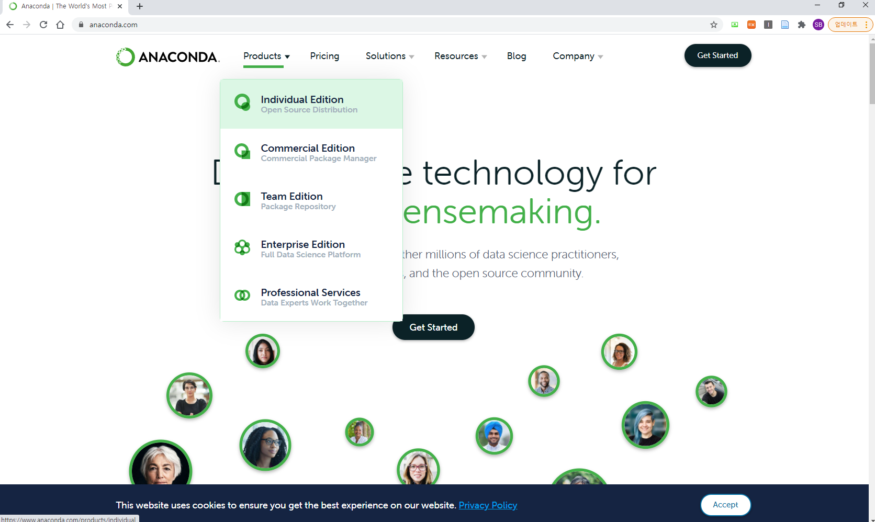
Environment setup - Anaconda
Go to https://www.anaconda.com/
Click Products – Individual Edition

Slide 6
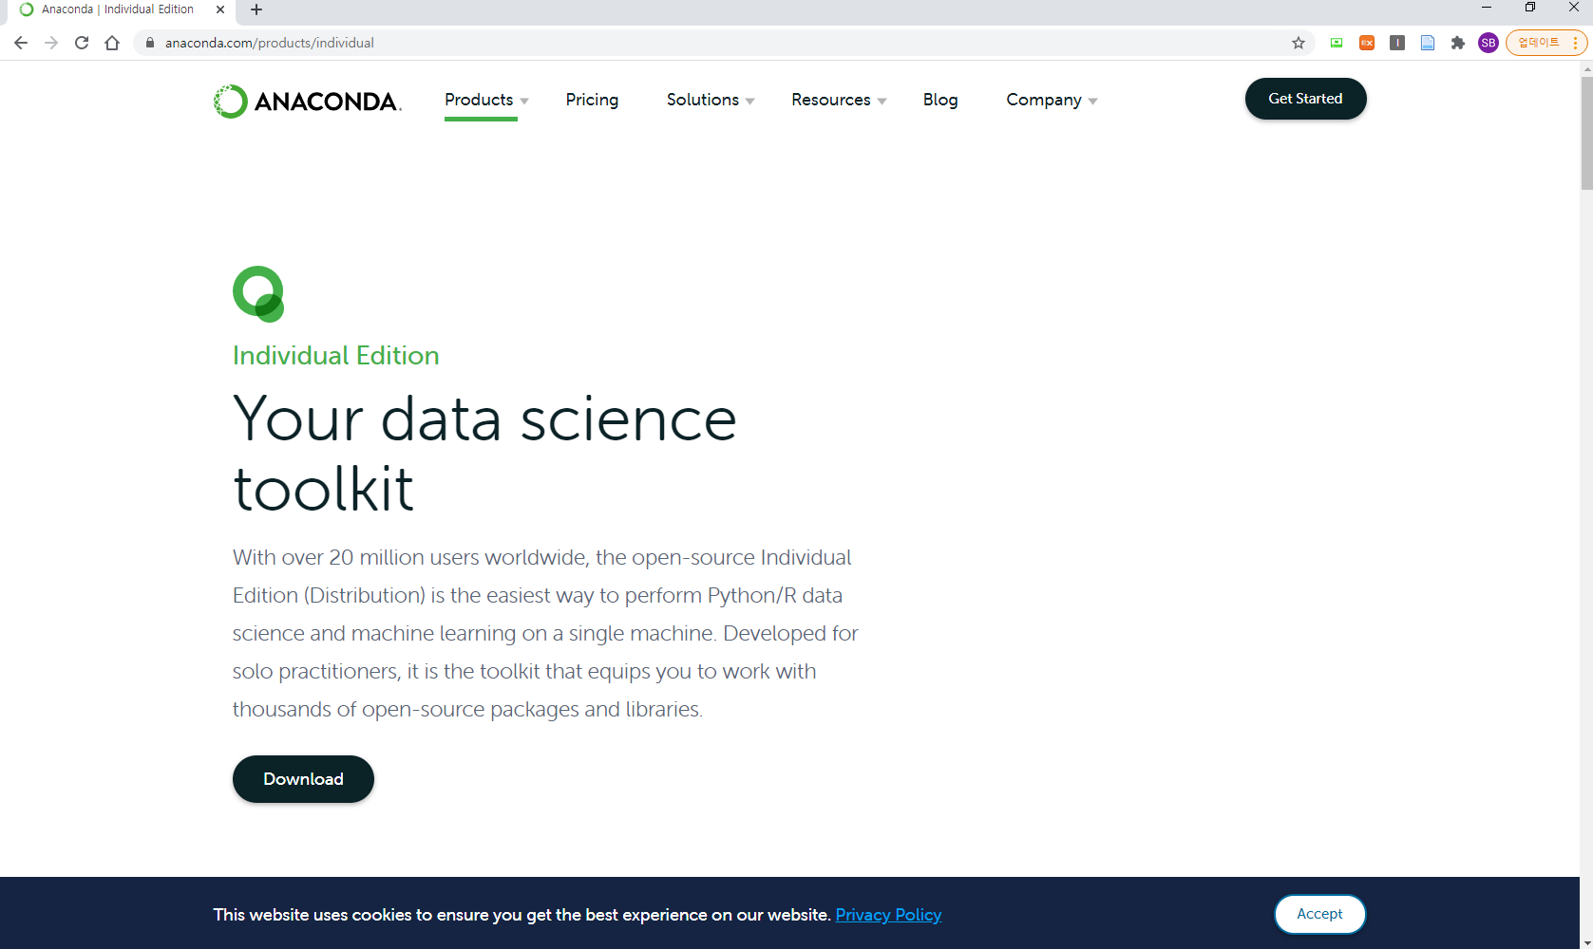
Environment setup - Anaconda
Click Download

Slide 7
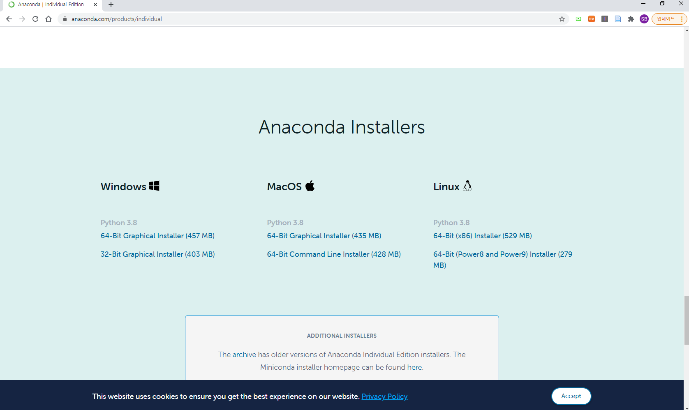
Environment setup - Anaconda
Choose a version for your system
Download will begin

Slide 8
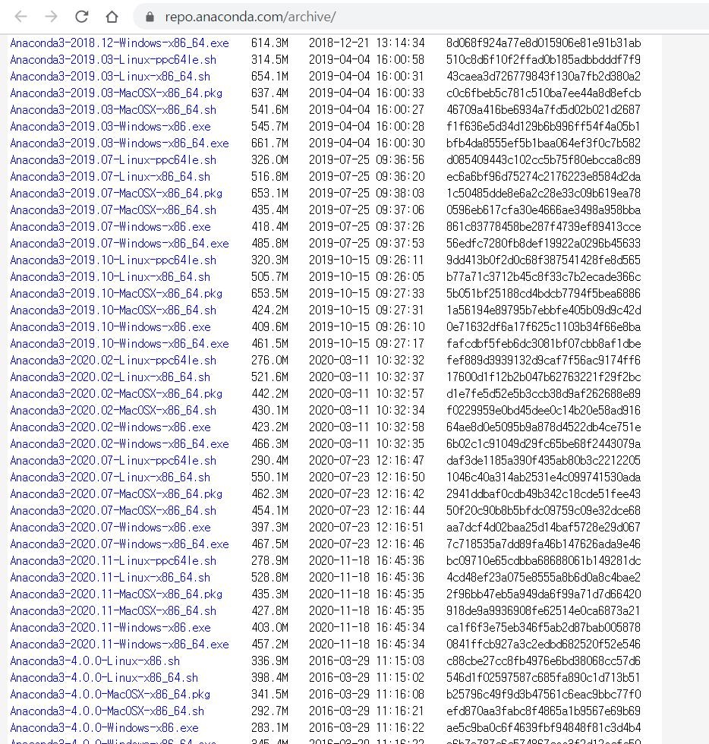
Environment setup - Anaconda
If the latest version of Anaconda is above 1.10.0 and you want to use 1.10.0, use this webpage.
https://repo.anaconda.com/archive/
Download Anaconda3-2020.11-

Slide 9
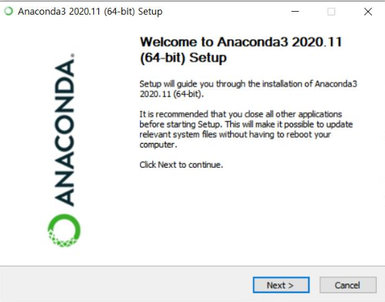
Environment setup - Anaconda
.

Slide 10
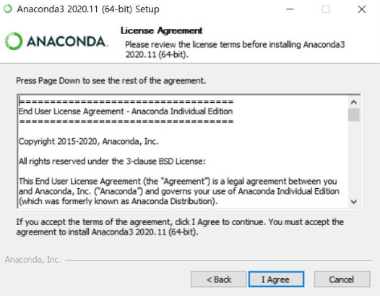
Environment setup - Anaconda
.

Slide 11
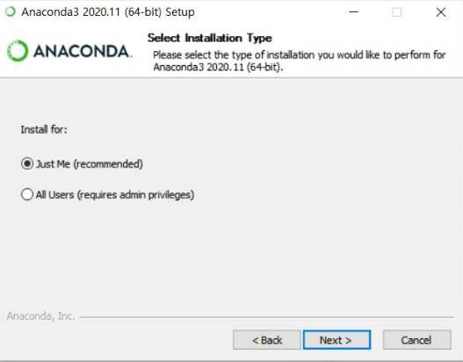
Environment setup - Anaconda
.

Slide 12
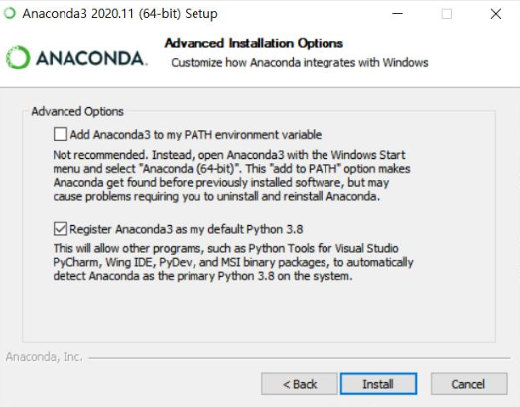
Environment setup - Anaconda
.

Slide 13
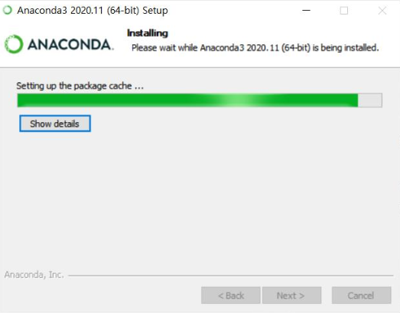
Environment setup - Anaconda
.

Slide 14
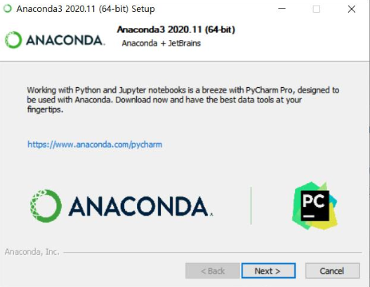
Environment setup - Anaconda
.

Slide 15
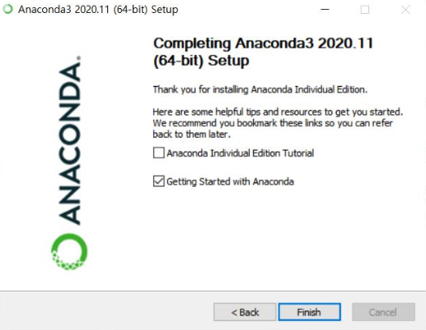
Environment setup - Anaconda
.

Slide 16
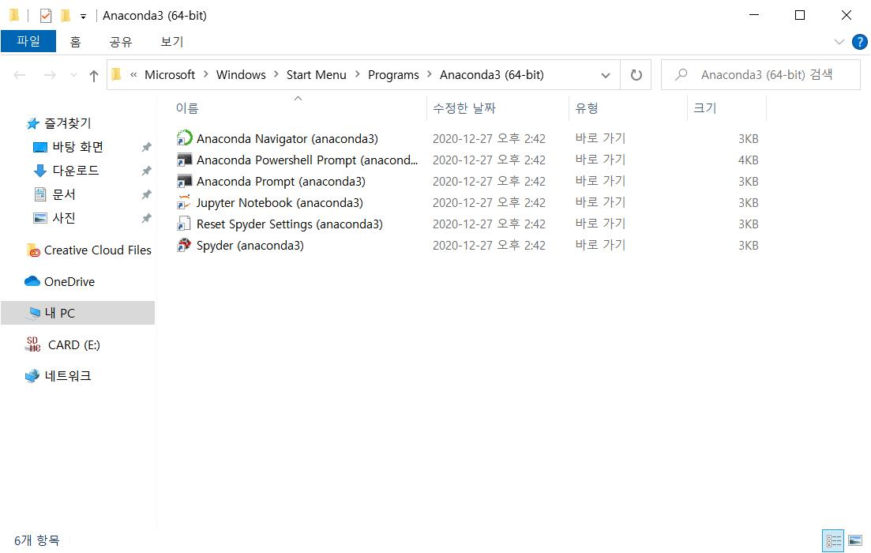
Environment setup - Anaconda
.
Run Anaconda Navigator

Slide 17
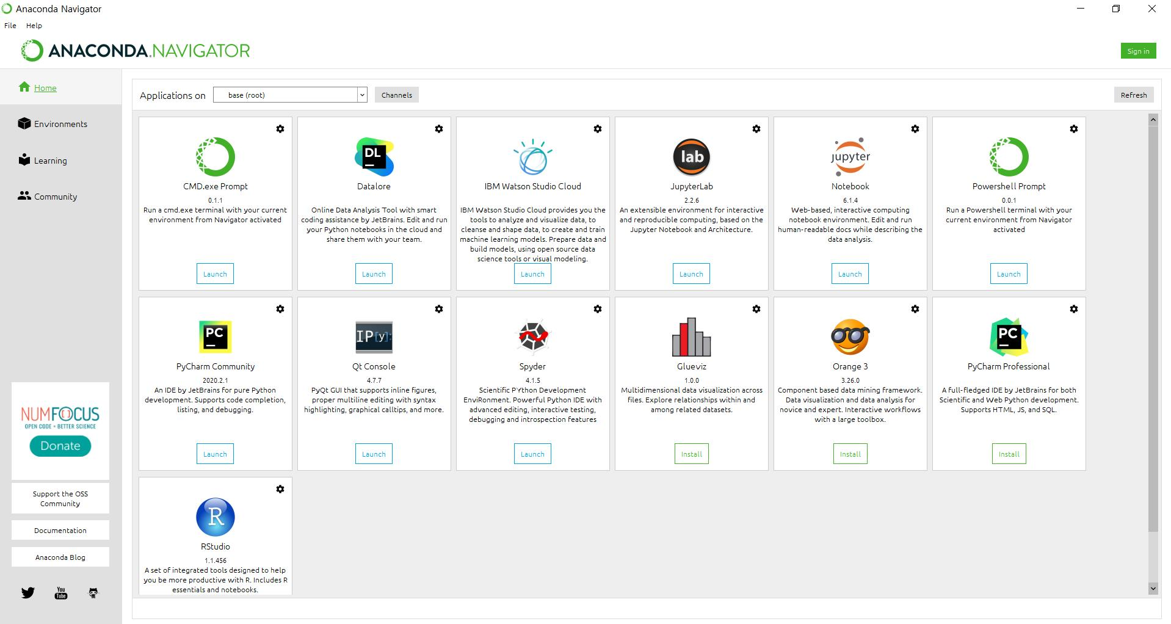
Environment setup - Virtual Environment
.

Slide 18
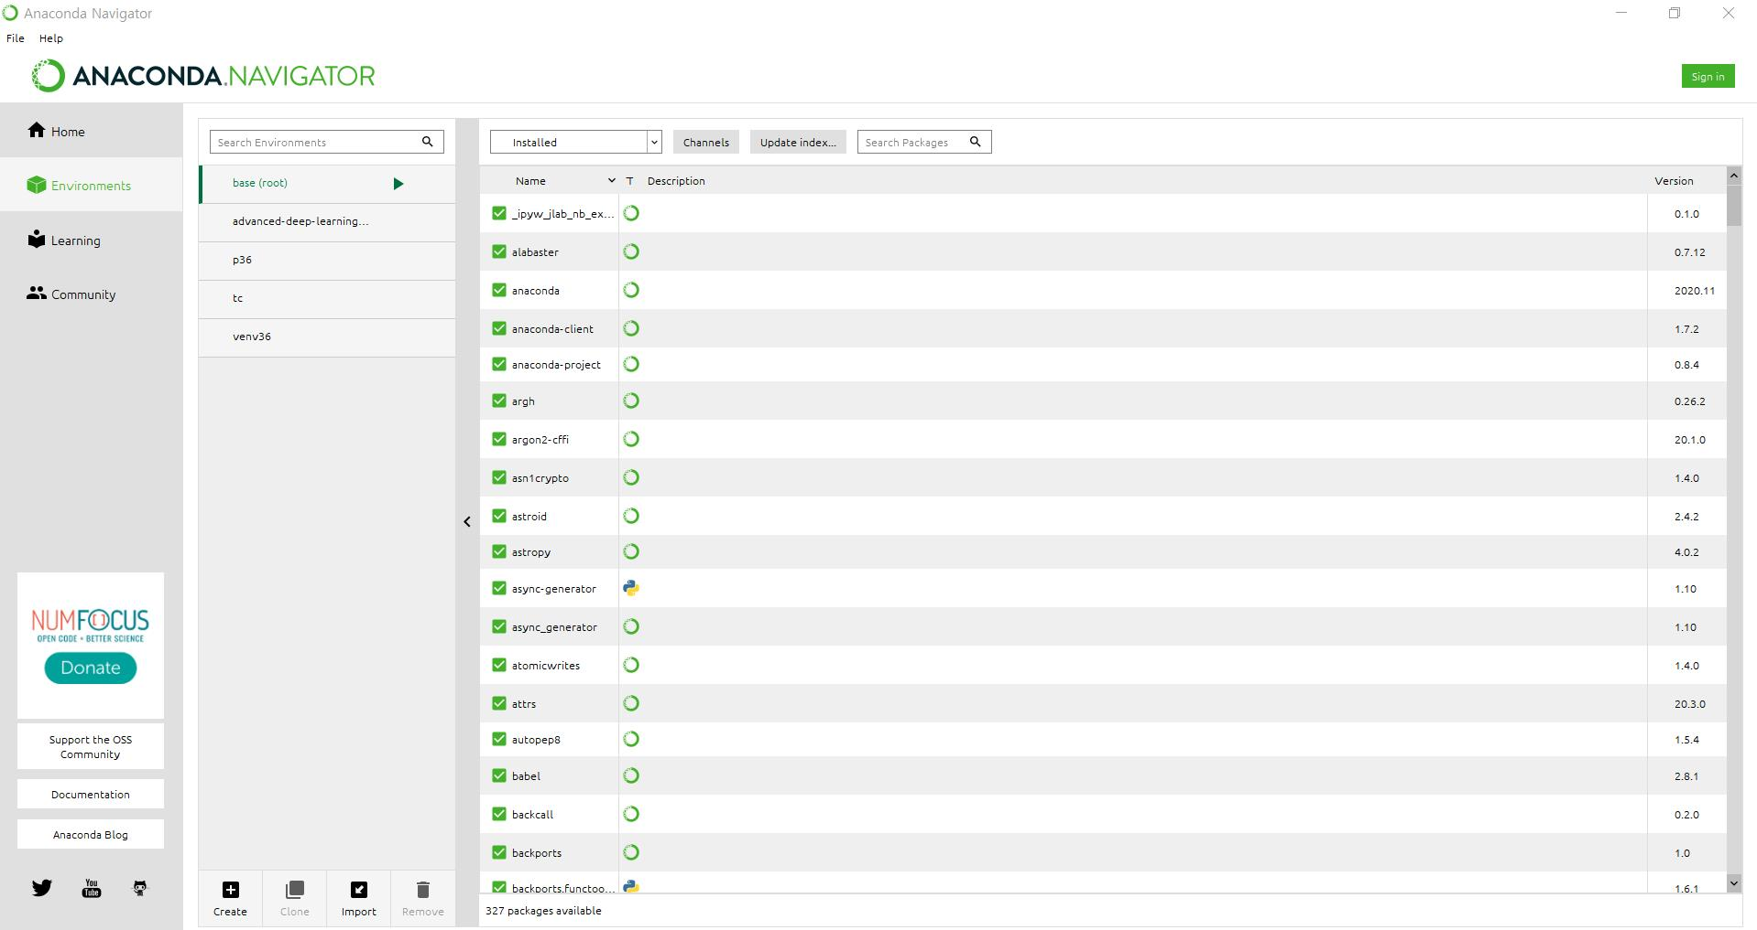
Environment setup - Virtual Environment
.

Slide 19
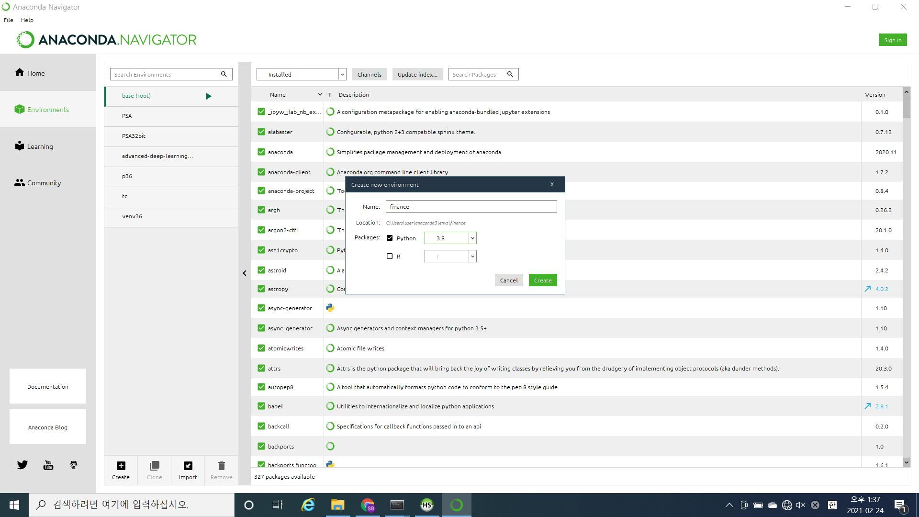
Environment setup - Virtual Environment
.
I named it ‘finance’
Select Python version 3.8

Slide 20
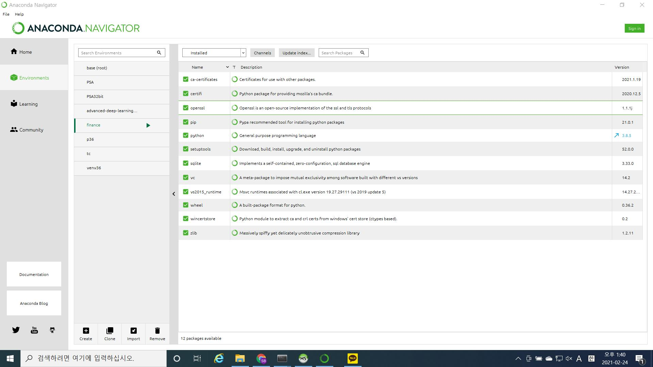
Environment setup - Virtual Environment
.
We will downgrade this
to Python version 3.8.1

Slide 21
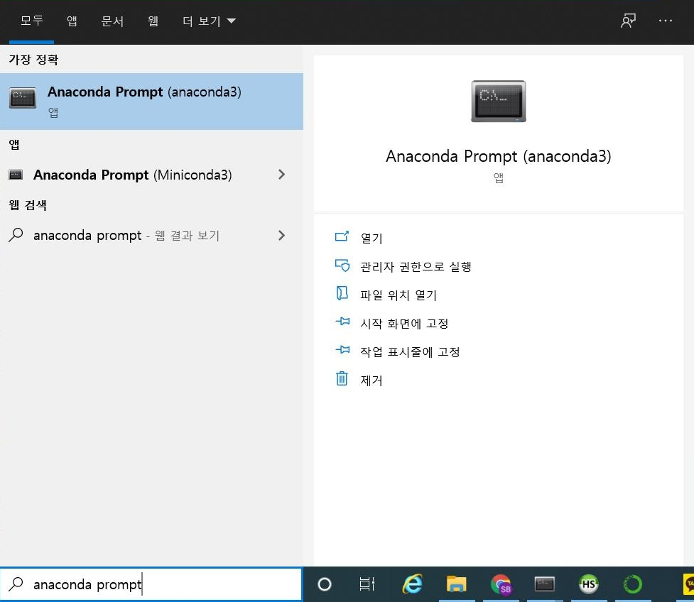
Environment setup - Virtual Environment
.
Run Anaconda Prompt

Slide 22
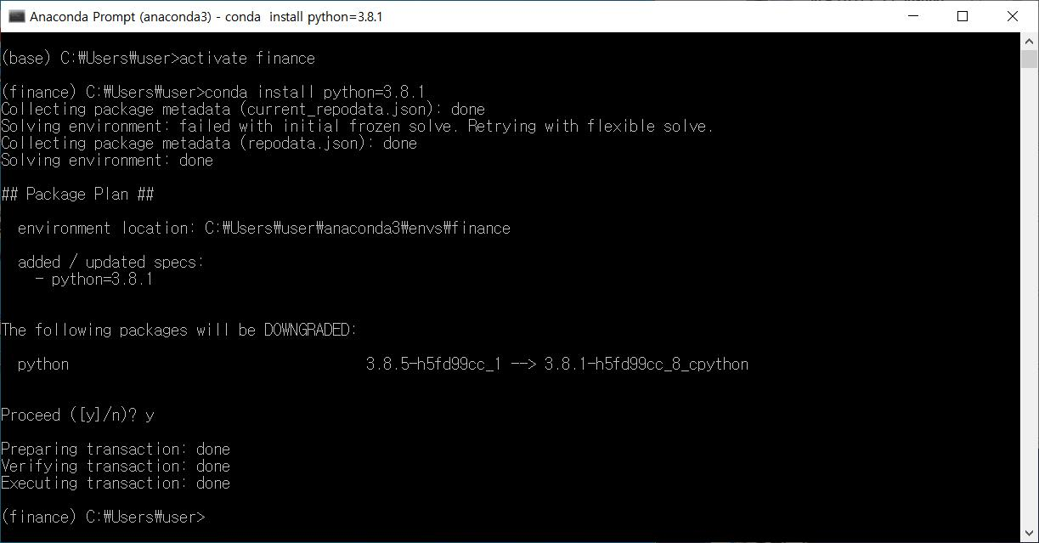
Environment setup - Virtual Environment
We will use the virtual environment ‘finance’.
You should use this same virtual environment later on for this program.
.
Installing Python 3.8.1

Slide 23
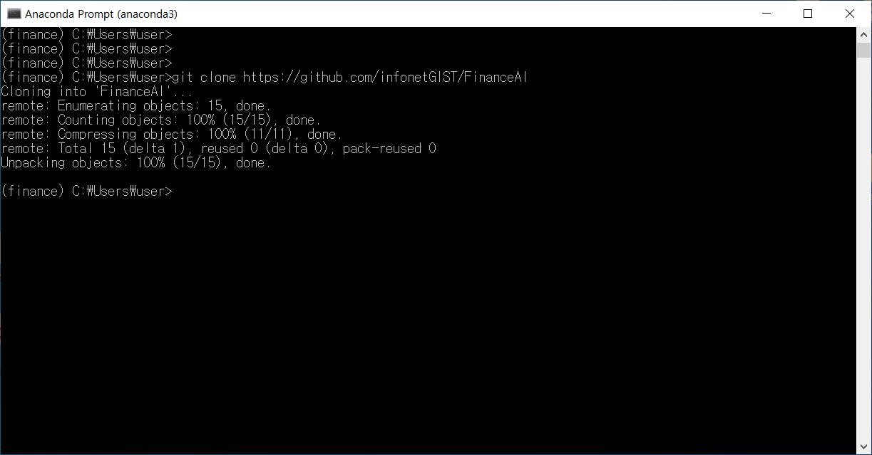
Environment setup - Libraries
.
Downloading source files from github

Slide 24
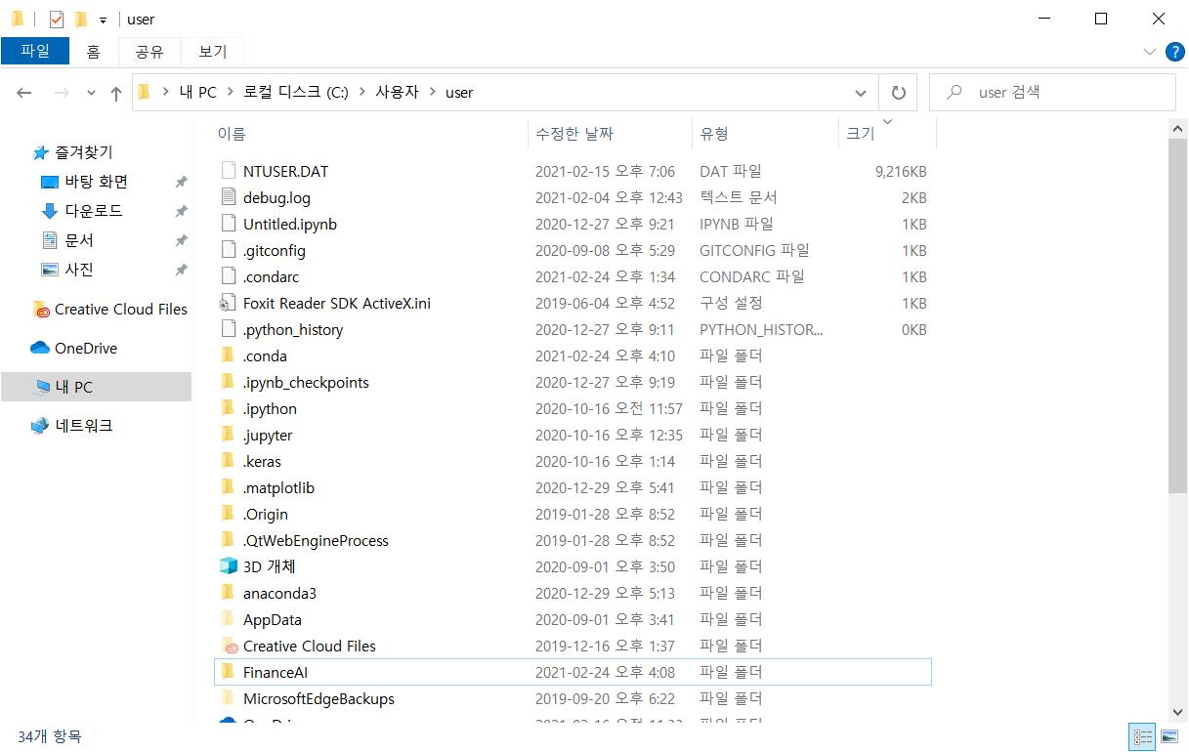
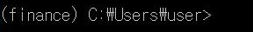
Environment setup - Libraries
Then you can see a folder named ‘FinanceAI’ in the current working directory of your anaconda prompt.
In this case, the current working directory is C:\Users\user

Slide 25
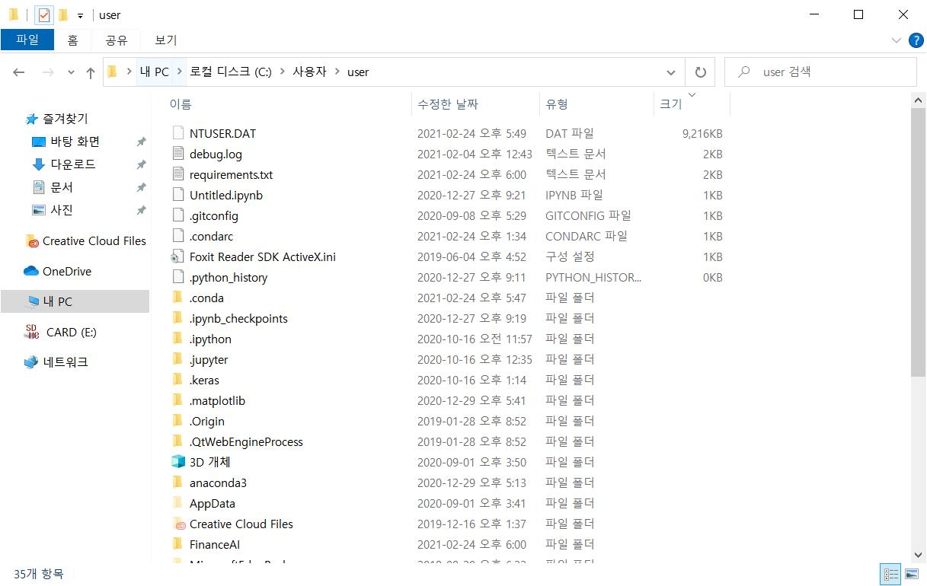
Environment setup - Libraries
In the folder, there is a file named ‘requirements.txt’.
Move the file to the current working directory, i.e., C:\Users\user
Then go back to anaconda prompt.

Slide 26
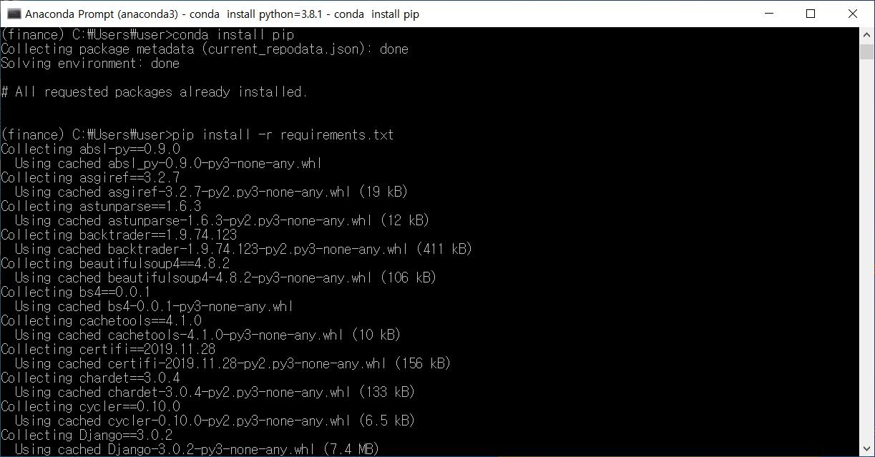
Environment setup - Libraries
Installing pip package manager to this virtual environment
.
Installing libraries written in the requirements.txt

Slide 27
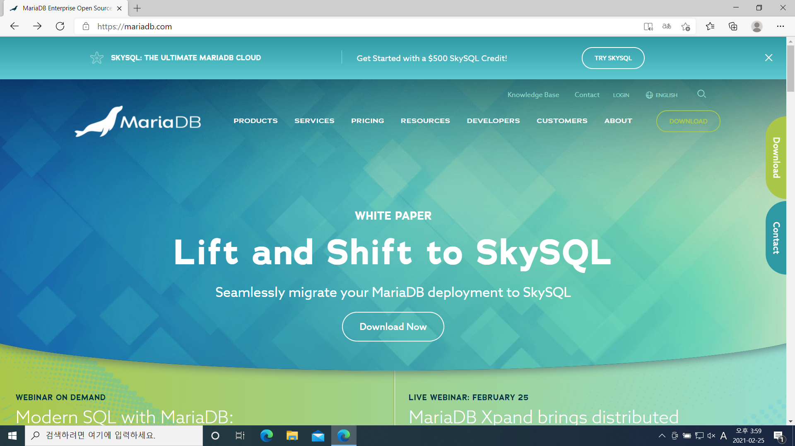
Environment setup - MariaDB
Now the virtual environment and its libraries have been installed.
Let’s install database software, MariaDB 10.5.
Go to https://mariadb.com
click DOWNLOAD

Slide 28
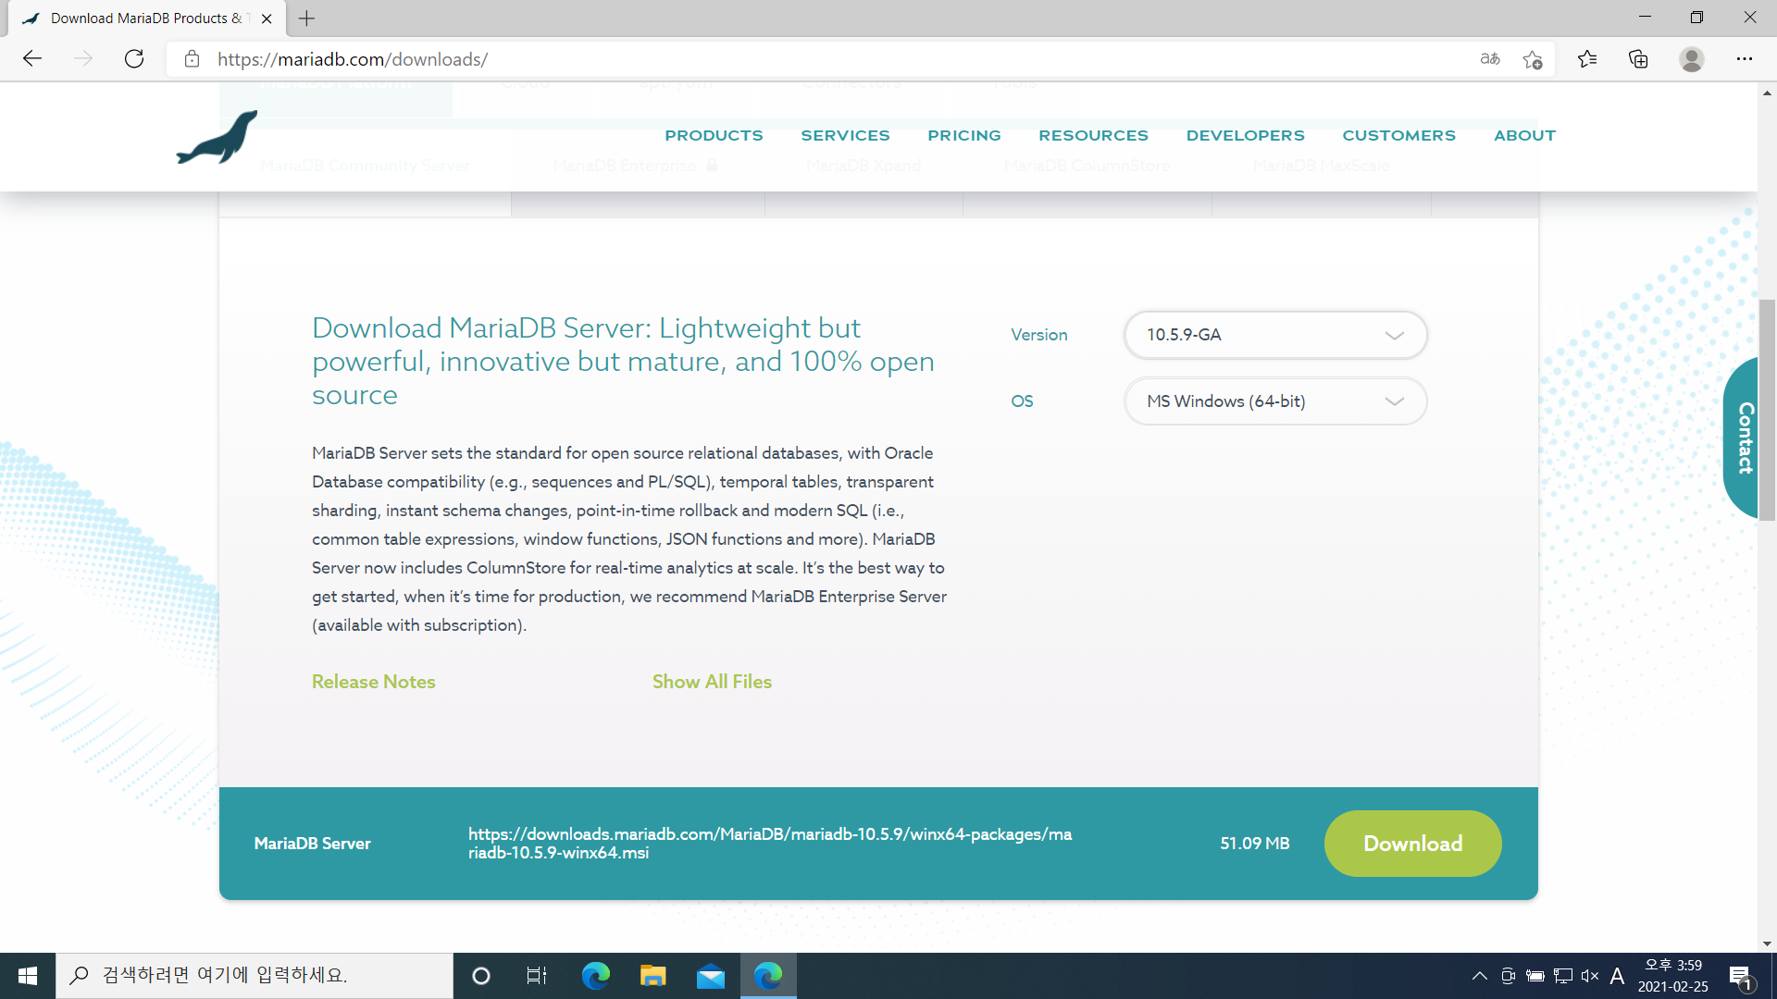
Environment setup - MariaDB
Select OS and Version, then Download
If you want to download the version that is same as mine, go to ‘Show All Files’

Slide 29
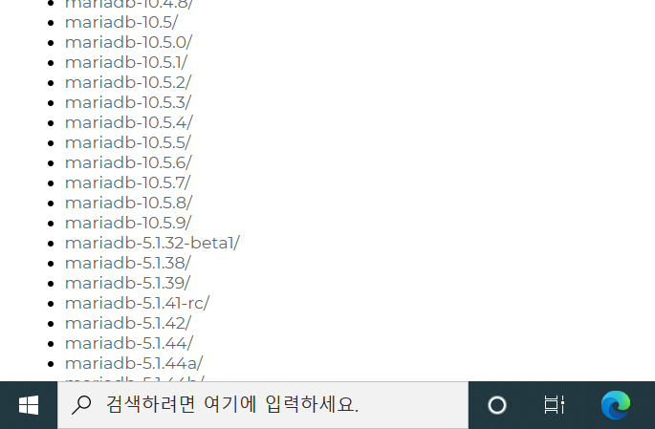
Environment setup - MariaDB
If you clicked ‘Show All Files’, choose mariadb-10.5.8/

Slide 30
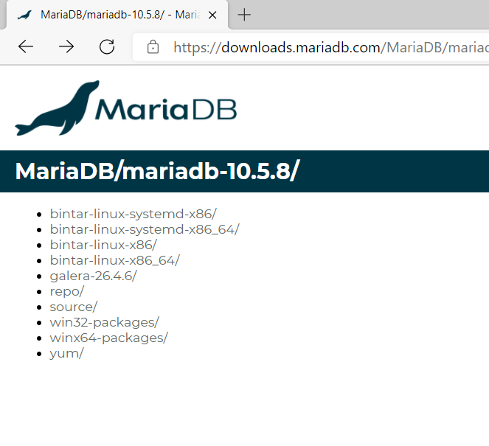
Environment setup - MariaDB
Select your OS

Slide 31
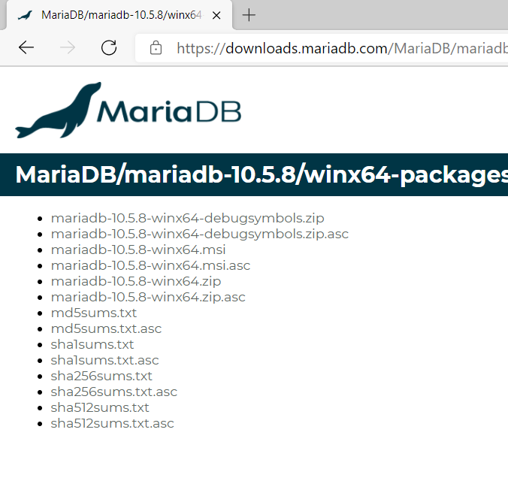
Environment setup - MariaDB
If you are using Windows, choose .msi file

Slide 32
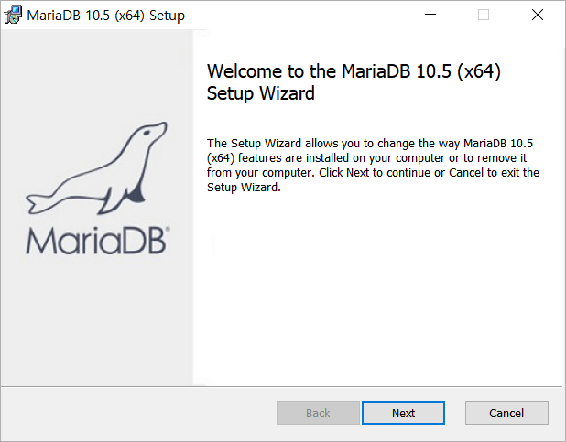
Environment setup - MariaDB
Install MariaDB

Slide 33
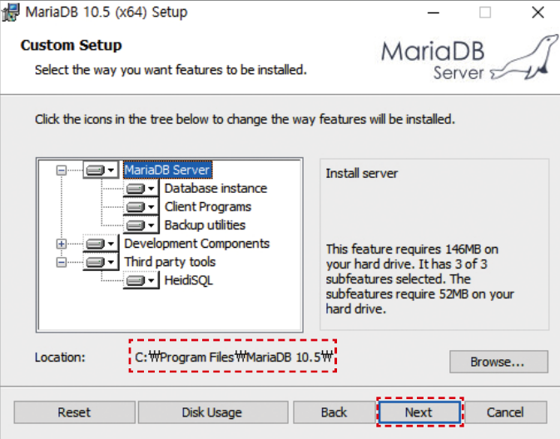
Environment setup - MariaDB

Slide 34
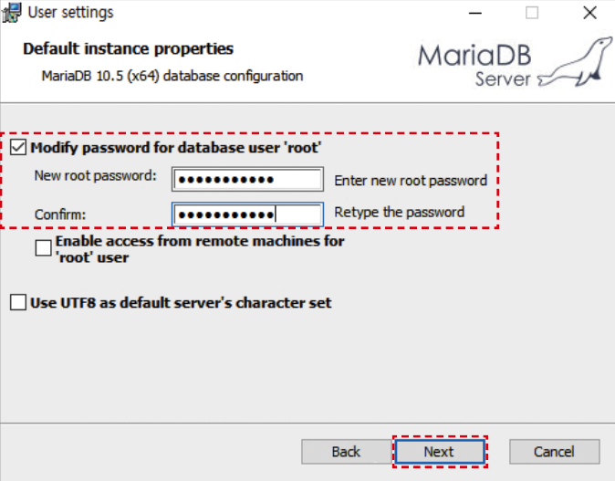
Environment setup - MariaDB

Slide 35
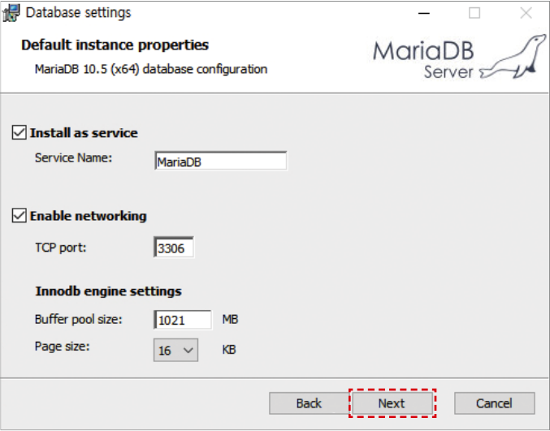
Environment setup - MariaDB
Set Buffer pool size to 60% of your memory size. For the rest of it, just continue as default.

Slide 36
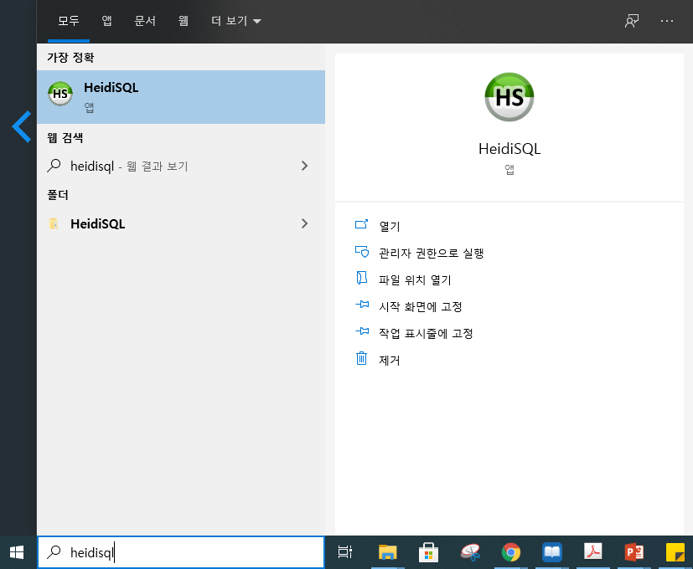
Environment setup - MariaDB
HeidiSQL is automatically installed during the MariaDB installation.
HeidiSQL is GUI based software for managing database.

Slide 37
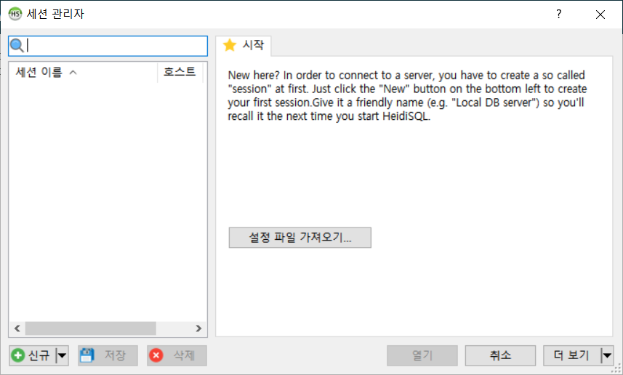
Environment setup - MariaDB
Let’s make an ID for database system.

Slide 38
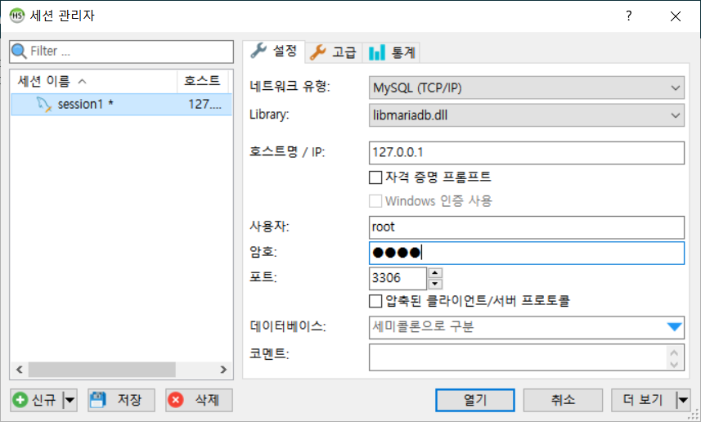
Environment setup - MariaDB
Type session name
Type username and password
An ID for database system is made.

Slide 39
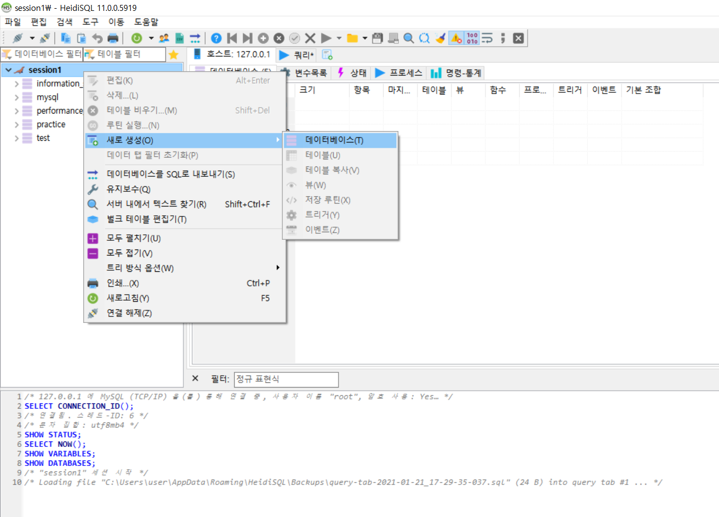
Environment setup - MariaDB
Make a database for OHLC data

Slide 40
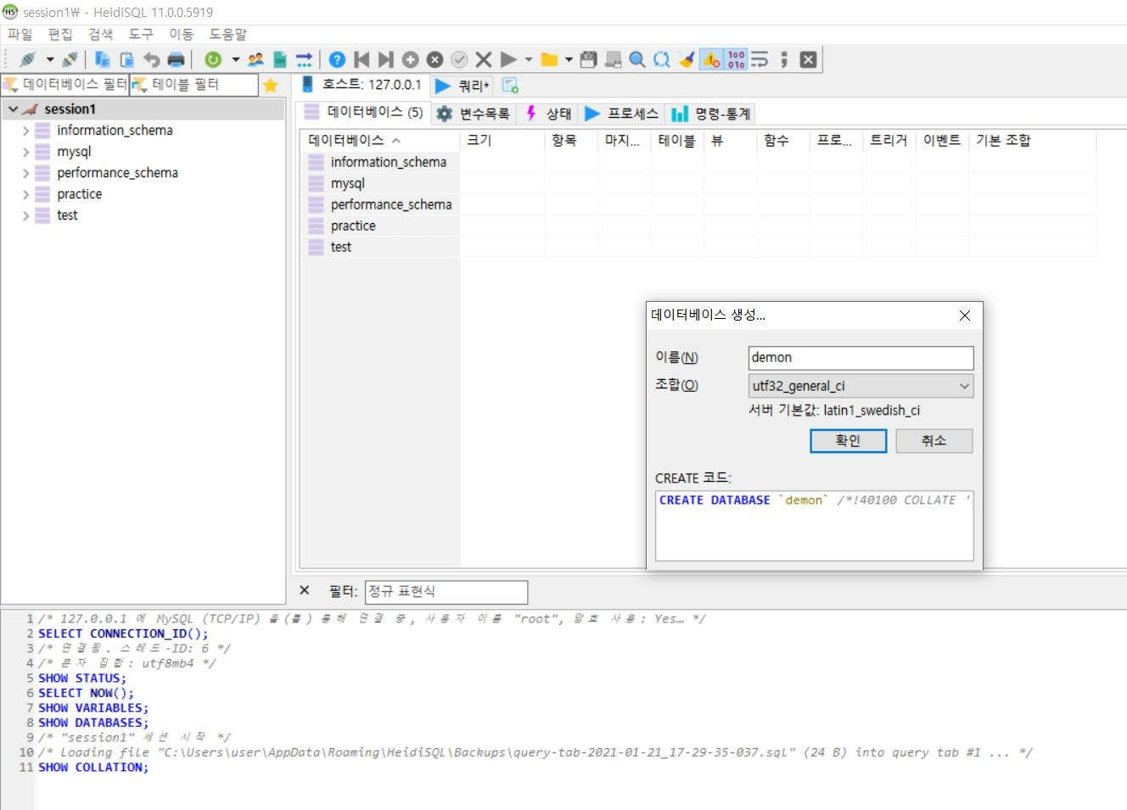
Environment setup - MariaDB
Make a database for OHLC data
Type name of the database
Choose utf32_general_ci

Slide 41
Editing parameter for DB connection
Now all the environment setting have been completed.
Go back to FinanceAI folder that was downloaded.

Slide 42
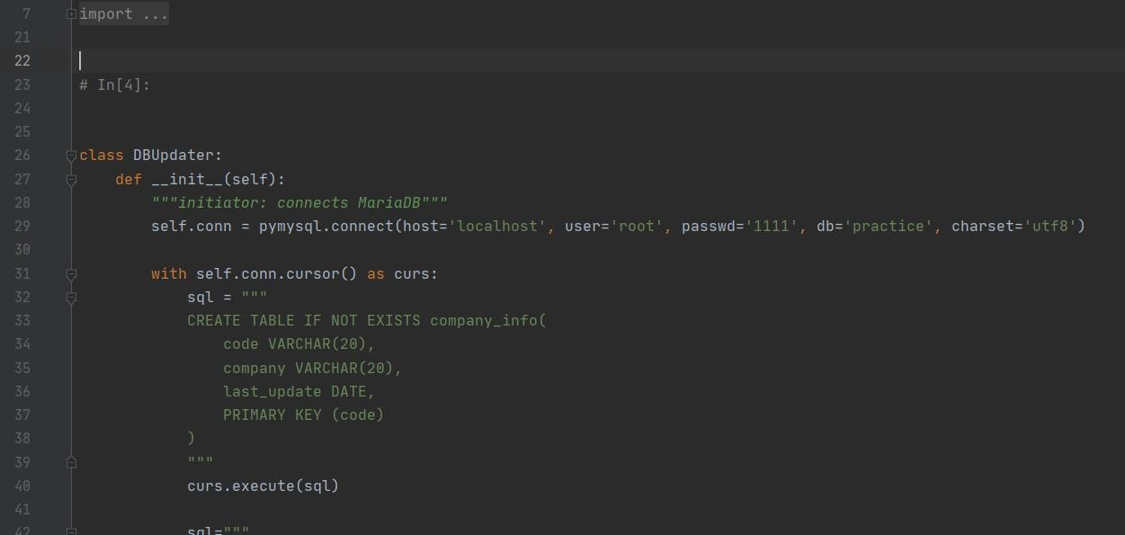
Editing parameter for DB connection
In the folder, open DBUpdater.py using a python editor.
Change the parameters (user, passwd, and db) of pymysql.connect as what you set.
user=‘root’, passwd=‘2222’, db=‘demon’

Slide 43
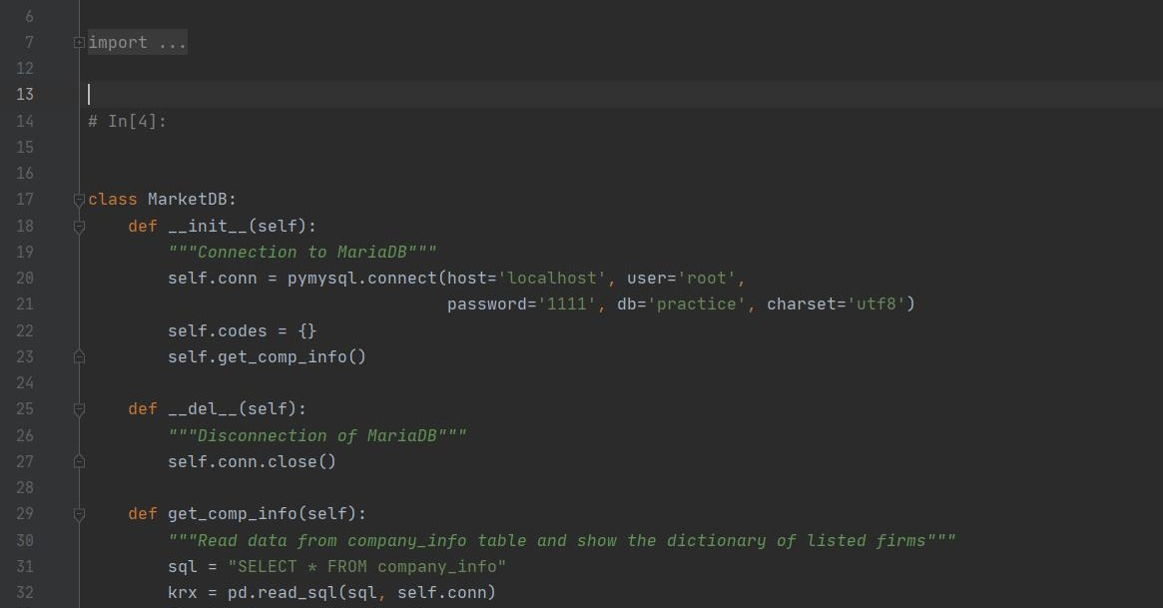
Editing parameter for DB connection
Do the same for Analyzer.py

Slide 44
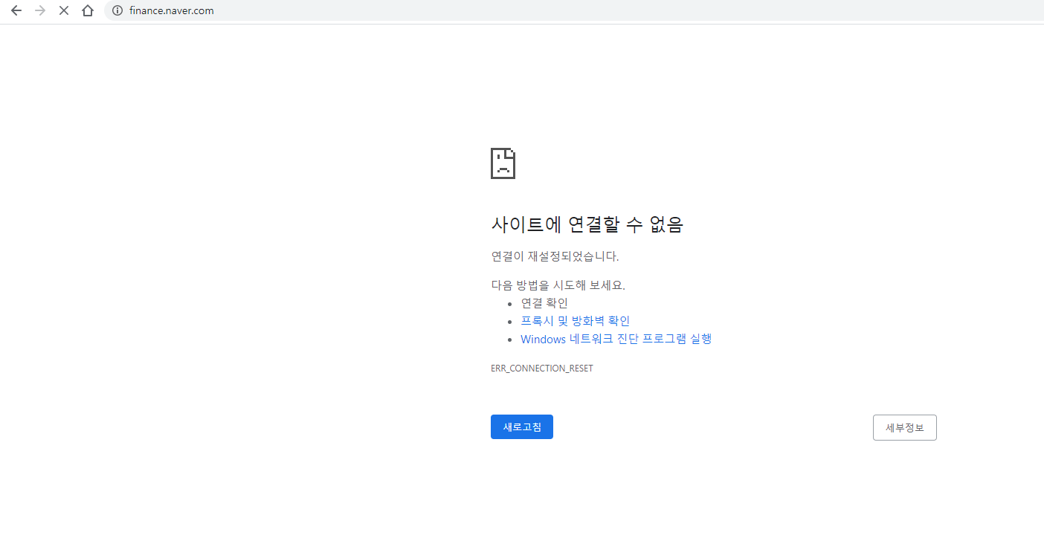
Webpage access check
Since this program utilizes Naver Finance and KRX webpage, you should check if you can access to these webpages.
If your network blocks these sites, then you need to detour it.
Use VPN, Hotspot or Tethering

Slide 45
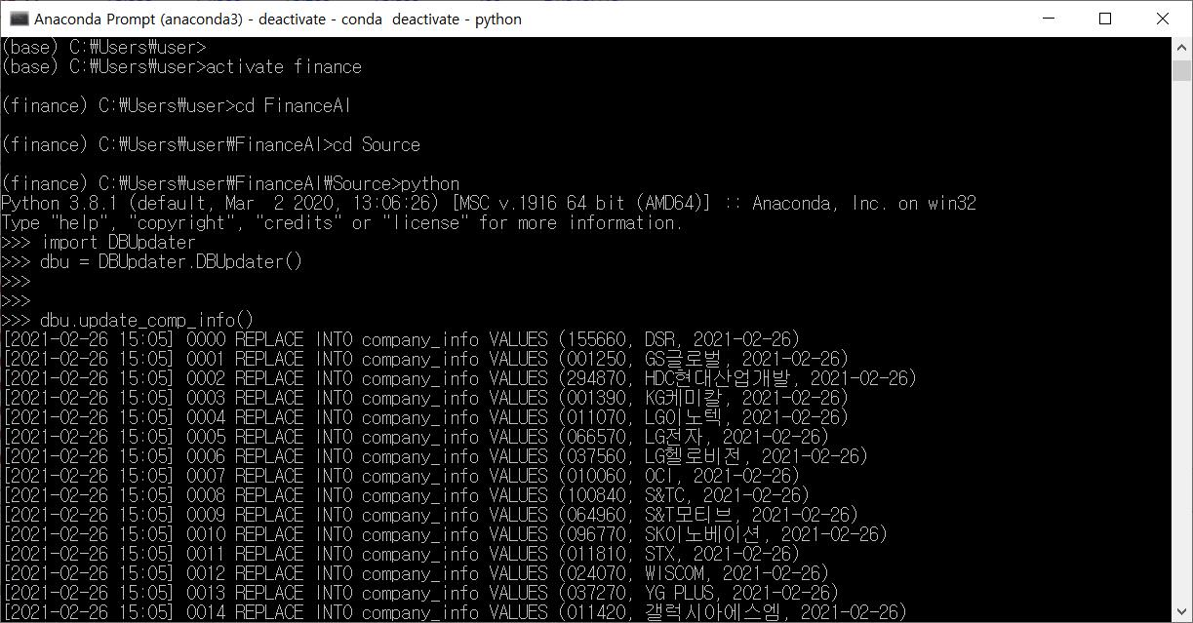
Updating list of listed companies
Now you are ready to update OHLC data into DB and to use API for DB lookup.
Go back to anaconda prompt.
Make sure you are still in the ‘finance’ environment.
If not, activate finance.
Move to Source folder.

Slide 46
Updating list of listed companies
Running python
Importing DBUpdater.py
and making instance named dbu.

Slide 47
Updating list of listed companies
update_comp_info() method updates list of listed companies into the database.

Slide 48
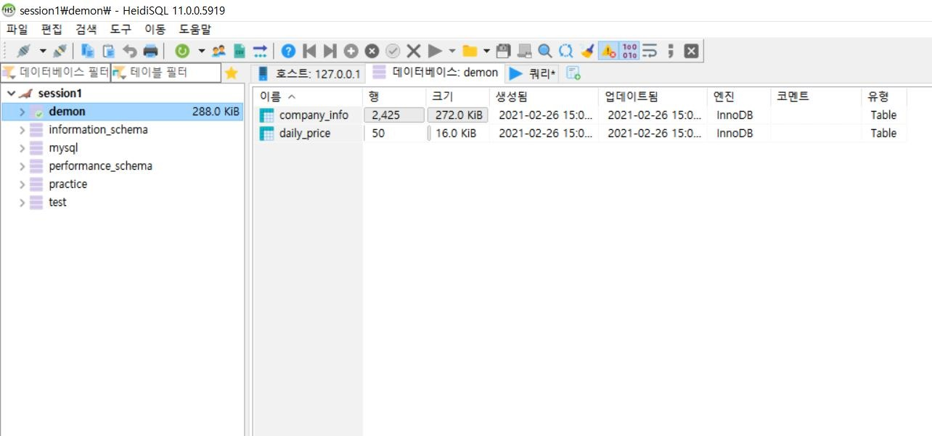
Updating list of listed companies
Let’s check if listed companies are actually updated into the database.
In the HeidiSQL, click the database that you have made and click refresh button.

Slide 49
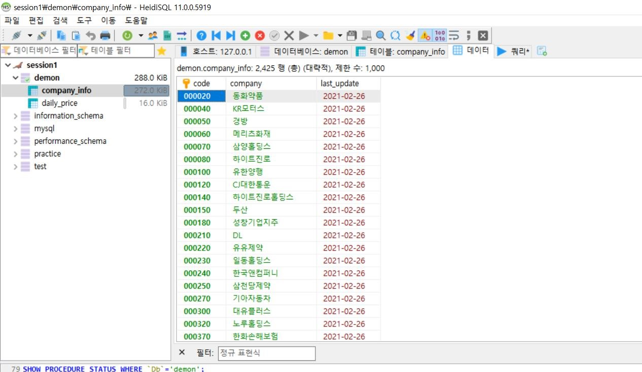
Updating list of listed companies
Double click company_info table below the database.
In Data tab, you can see the code number and name of the listed companies.

Slide 50
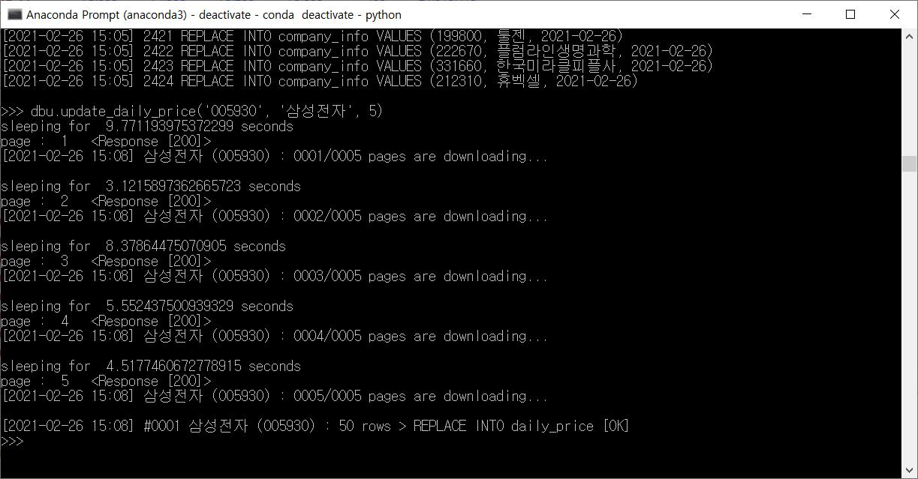
Updating OHLC data
Updating OHLC data is done by update_daily_price() method.
For the parameters, you can copy and paste texts from the company_info table.
5 pages of OHLC data of Samsung Electronics are read from Naver Finance and updated into the database.
If you want to update every OHLC data of it, just skip the third parameter.
It says 50 rows of OHLC data has been updated.

Slide 51
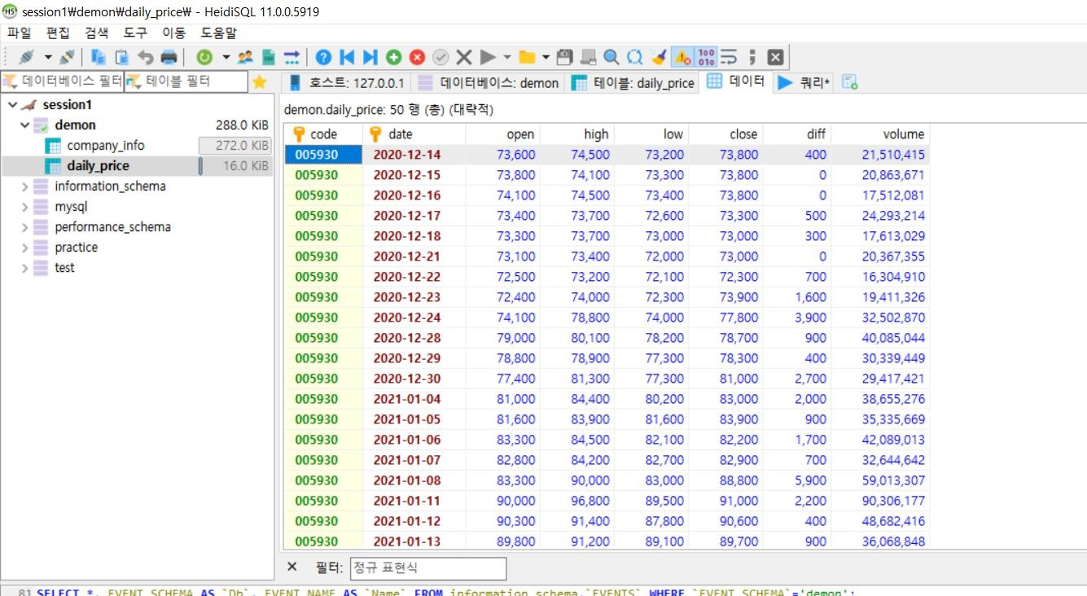
Updating OHLC data
In the HeidiSQL, again refresh the database.
Then you can check the updated data in the data tab of daily_price table.

Slide 52
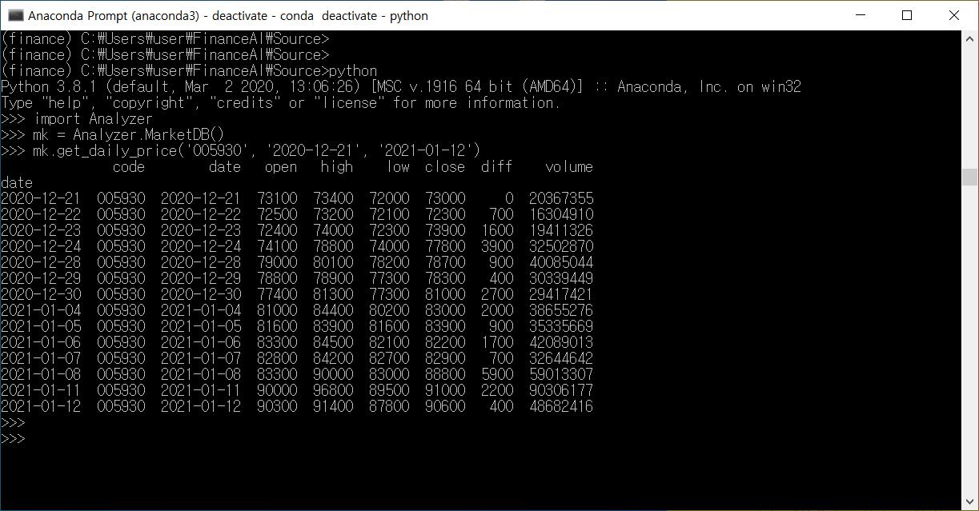
Data inquiry from DB
Now you can use Analyzer.py as an API of the database.
In the anaconda prompt, type ctrl+z to terminate python, and start python again.
Importing Analyzer.py
and making instance named mk.
The OHLC data that is fetched.
get_daily_price() method queries to daily_price table in the database.
In this example, the OHLC data of Samsung Electronics from 2020-12-21 to 2021-01-12 is being fetched.

Slide 53
Thank you

